Slide 1
Multiple Regression
SSI II
February 19, 2018

Slide 2
Previously…
Causal hurdles and the importance of controlling for Z
Bivariate Regression

Slide 3
Essential Questions
How does multivariate regression work?
Why is it important to have the right model?
How are significance and substantive effect related?

Slide 4
Bivariate vs. Multivariate
X
Y
Y
Z X/Z
X Z Z
Notes:
Our theories are often bivariate, but reality is multivariate

Slide 5



Controlling for Z
Helps make sure the relationship is not spurious
Helps us see the real relationship between X and Y

Slide 6
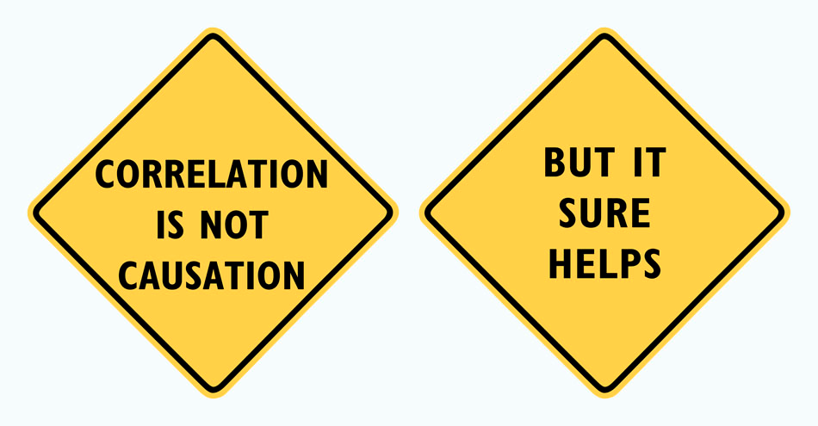
Correlation and Causation

Slide 7

Four Causal Hurdles
1) Is there a credible causal mechanism that connects X to Y?
2) Can we rule out the possibility that Y could cause X?
3) Is there covariation (correlation) between X and Y?
4) Have we controlled for all confounding variables (Z) that might make the association between X and Y spurious?

Slide 8
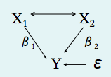
Multiple Regression

Slide 9
Logic
Take out the part of X₁ that is related to X₂, and take out the part of Y that is related to X₂, and then regress what is left from X₁ on what is left from Y
This is then the effect of X₁ on Y with no influence of X₂ on the process at all, or “controlling for X₂” or “holding X₂ constant”
These effects are sometimes called “partial slopes”

Slide 10
Multiple regression as “partialling out” Z
To obtain the independent effect of X on Y while controlling for Z we used a three step process:
“Purge” effect of Z from Y (residuals = part Y not explained by Z)
“Purge” effect of Z from X (residuals = part of X not explained by Z)
Estimate regression using both “purged” variables
Slope coefficient from Step 3 is the independent effect of X on Y controlling for Z (“purged” of Z)

Slide 11
Multiple regression coefficients
Increase in Y for a one unit increase in X holding Z constant
Increase in Y for a one unit increase in Z holding X constant
In general, each coefficient represents the independent effect of a change in a variable holding all other variables in the model constant
Multiple regression is used to statistically control for Z factors
Notes:
Beta-1 equals the partial derivative of Y over the partial derivative of X (the partial derivative is the derivative with respect to one variable, with all others held constant)
IMPORTANT – WE CAN ONLY THINK OF REGRESSION COEFFICIENTS AS HOLDING CONSTANT THE VARIABLES INCLUDED IN THEMODEL (this is a limitation of observational studies)

Slide 12
Bivariate to Multivariate Model
β from a bivariate model will almost always be different from β₁ in a multivariate model
Can be a small difference
Can be a big difference in the size of the coefficient
Can be a difference in the sign of the coefficient
Can change the significance of the effect

Slide 13
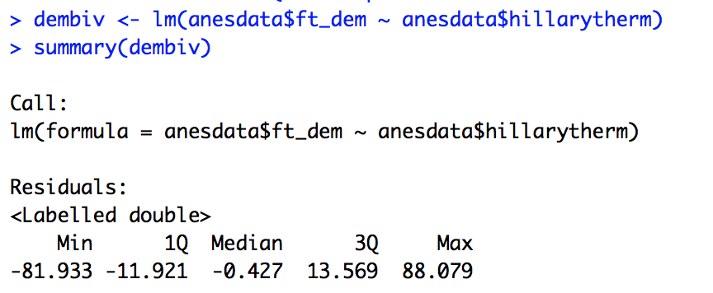
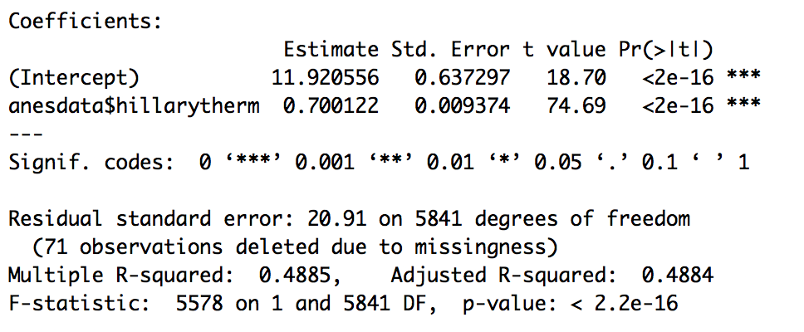
Example: HillaryTherm and DemocratTherm
Bivariate Regression – β-hat=.700

Slide 14
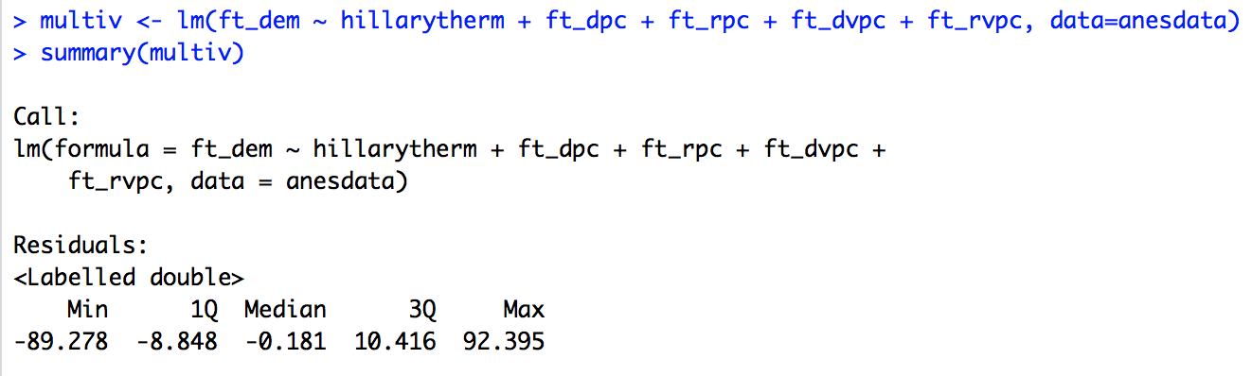
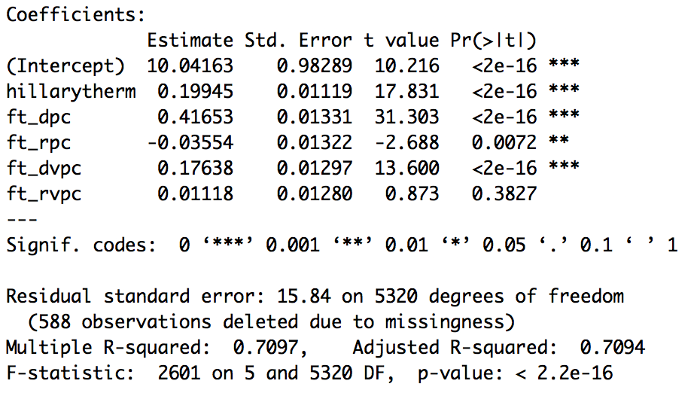
Example: HillaryTherm and DemocratTherm
Bivariate Regression – β-hat=.700
Multivariate Regression – β₁-hat=.199

Slide 15
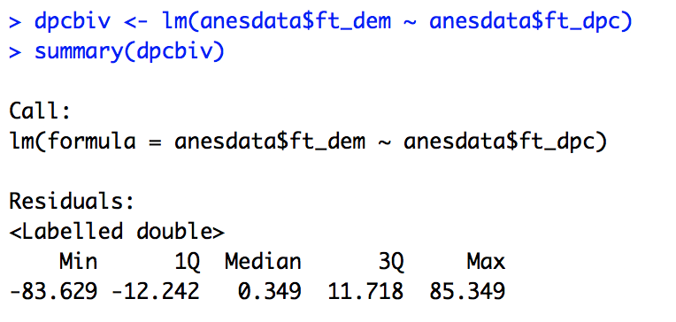
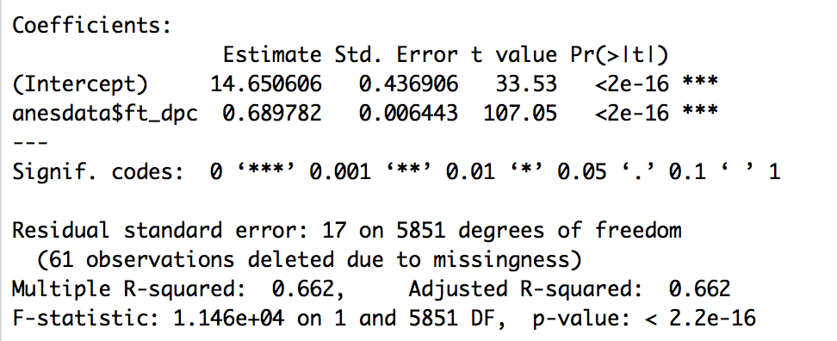
Example: Dem Pres Cand Therm (Obama) and Democrat Therm
Bivariate Regression – β-hat=.690

Slide 16
Example: Dem Pres Cand Therm (Obama) and Democrat Therm
Bivariate Regression – β-hat=.690
Multivariate Regression – β2-hat=.417 p=0.012

Slide 17
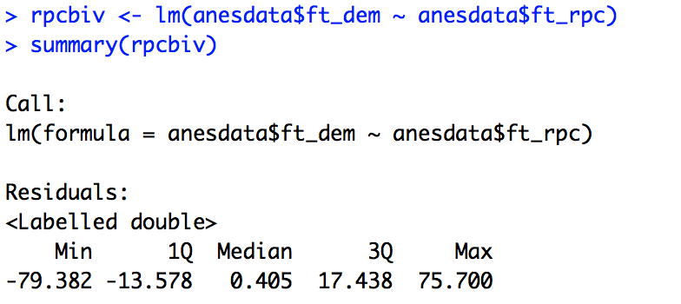
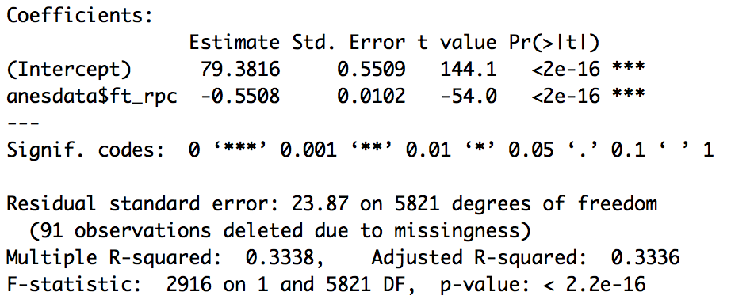
Example: Rep Pres Cand Therm (Romney) and Democrat Therm
Bivariate Regression – βhat=-.551

Slide 18
Example: Rep Pres Cand Therm (Romney) and Democrat Therm
Bivariate Regression – βhat=-.551, p <.000
Multivariate Reg. – β3hat=-.036, p=.0072

Slide 19
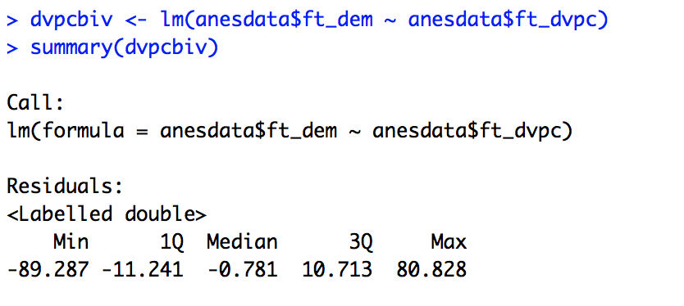
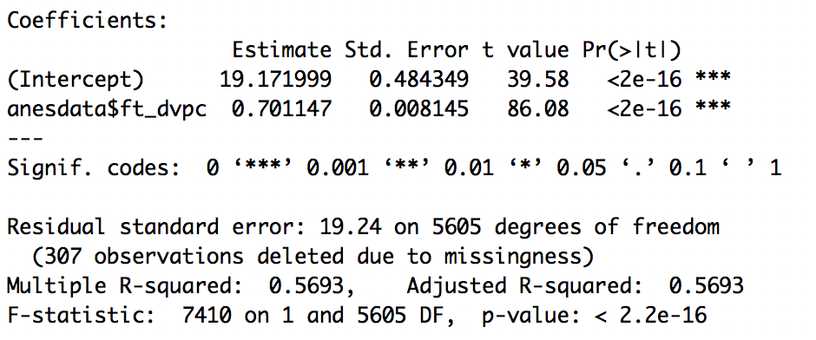
Example: Dem Vice Pres Cand Therm (Biden) and Democrat Therm
Bivariate Regression – βhat=.701

Slide 20
Example: Dem Vice Pres Cand Therm (Biden) and Democrat Therm
Bivariate Regression – β=.701
Multivariate Regression – β4hat=.176

Slide 21
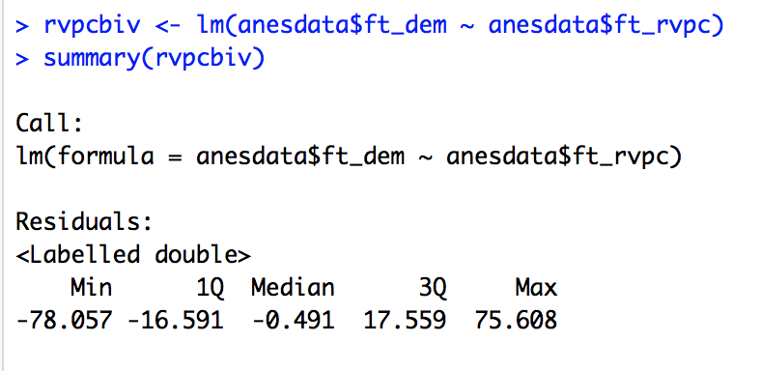

Example: Rep Vice Pres Cand Therm (Ryan) and Democrat Therm
Bivariate Regression – βhat=-.537, p<.000

Slide 22
Example: Rep Vice Pres Cand Therm (Ryan) and Democrat Therm
Bivariate Regression – βhat=-.537, p<.000
Multivariate Reg. – β5hat=-.011, p=.383

Slide 23
Controlling for Z
This is important as long as X and Z are correlated
Any correlation will affect their individual effect on Y
They do not have to be causally related
They do not have to be highly correlated
Any correlation above 0 will affect our slope estimates

Slide 24




X and Z
If X and Z are related:
To predict X_{i}:
Via some algebra:
Which is equal to:
So are the residuals, and the portion of the variation in X that Z cannot explain - X “purged” of Z

Slide 25




Y and Z
If Y and Z are related:
To predict Y_{i}:
Via some algebra:
Which is equal to:
So are the residuals, and the portion of the variation in Y that Z cannot explain - Y “purged” of Z

Slide 26



Effect of X on Y, Purged of Z
The formula for , representing the effect of X on Y while controlling for Z, is equal to:
Substituting in from the last two slides, we get:

Slide 27
Effect of X on Y, Purged of Z
The “hatted” components are what we predicted using Z
So now the formula for only uses what Z cannot account for – the and

Slide 28
Same Logic, Different Notation
Bivariate Slope:
Multivariate Slopes:
What is the difference? Multivariate slope subtracts out the joint correlation of X₁ and Y with X₂. That is what it means to “control” for X₂ (or to control for X₁ in the equation for β₂).
If all variables are positively related with each others, the multivariate slope will be smaller than the bivariate slope

Slide 29
Example
South Africa Data
St.Dev. Correlation Matrix
Political Knowledge 1.94 1.00
Civic Education 1.18 .216 1.00
Education 1.37 .562 .122 1.00
Bivariate slope for Civic Education on Knowledge:
Bivariate slope for Education on Knowledge:
Multivariate slopes:
Why the differences? The bivariate slopes overestimated the unique effects of each variable, misattributed the joint correlated effect of X₁ and X₂ on Y to the separate variables. This was especially the case with the effect of civic education.

Slide 30
More variables
The same logic holds as we add more variables to the model
But… we are still in trouble if we do not include all of the Z variables that matter

Slide 31
Omitted variables bias
Population regression
What if you estimate the wrong sample regression (by omitting Z)?
Notes:
the effect of Z is captured in u^hat

Slide 32
Omitted variables bias
Sampling distribution when Z is part of the population regression but omitted from the sample regression
When is omitting Z inconsequential?
Notes:
BIAS
Inconsequential when b2 = 0 or Cov(x,z) = 0
NOTE: We won’t necessarily know what the direction of the bias is unless we actually estimate the correct regression equation.

Slide 33
Omitting Z
It is okay to omit Z only if:
When β₂=0
When Cov(X,Z)=0
When X and Z are not related
It is unlikely that both of these conditions are met!

Slide 34
The Size of Omitted Variable Bias
From the equation, we can tell that the size of the bias depends on: β₂ and the covariance between X and Z
If both are small, the bias will be small
If both are large, the bias will be large
We may also be able to tell about direction
If β₁ and β₂ are both positive, and the covariance of X and Z is positive, our estimates will be larger than the true population parameter

Slide 35
Bias
Bias exists when the expected value of the parameter estimate that we obtain from a sample will not be equal to the true population parameter
Omitted variable bias is one type of bias

Slide 36
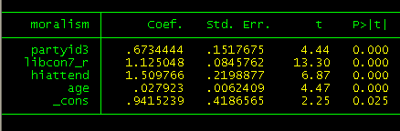
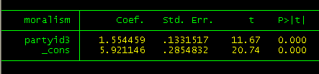
Multiple regression estimates
Bivariate regression (omitting ideology, church attendance, age)

Slide 37
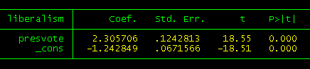
Omitted variables bias

Slide 38
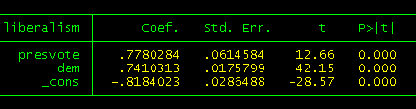
Controlling for Z

Slide 39
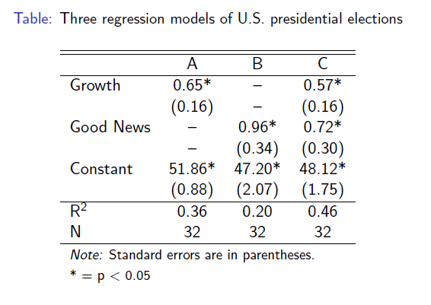
Example

Slide 40
“Bigger” and “Smaller” Effects
Tempting to say: The coefficient for growth is (0.57) and for good news is (0.72), so good news has a larger effect
But they are measured in different metrics, so we cannot do this
Growth is percentages and can be negative or as high as 5%
Good news is a count variable of quarters, and ranges from 0 to 10
So we cannot compare the size of these coefficients (as such)

Slide 41

Standardized Coefficients
We can use standard deviations to turn the unstandardized coefficients into standardized coefficients
We essentially remove the metrics of both the IV and DV by using their standard deviations

Slide 42
Interpreting Standardized Coefficients
They represent the expected standard deviation change in Y, given a one standard deviation increase in X

Slide 43


K & W Example
For growth:
For good news:

Slide 44
Significance and Substantive Impact
Statistical significance just tells us how confident we can be that the effect is positive or negative
Using a confidence interval, it can also tell us what type of effect we can be confident exists
Significance depends in large part on sample size
Substantive impact is about the size of the effect, and is more subjective

Slide 45
Additional Requirement
No two independent variables can be perfectly correlated
If they are, how can you tell their effect apart?

Slide 46
Multiple regression
Extends linear regression to more than one independent variable
Statistically controls for Z - coefficients interpreted as independent effects, controlling for all other variables
Same as “partialing out” or “purging” influence of Z
Omitted variables bias results from leaving out Z

Slide 47
Finkel (2002) – Civic Education and the Mobilization of Political Participation in Developing Democracies

Slide 48
Research Question
“Can individuals in emerging democracies learn democratic values, skills, and participatory orientations through civic education?”
Does such civic education increase their levels of participation?

Slide 49
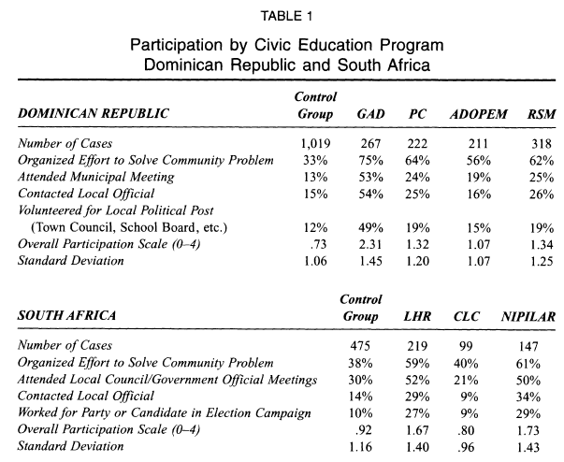
“Bivariate”

Slide 50
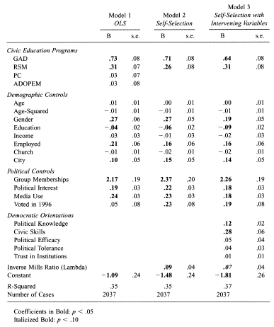
Multivar-iate Results for DR

Slide 51
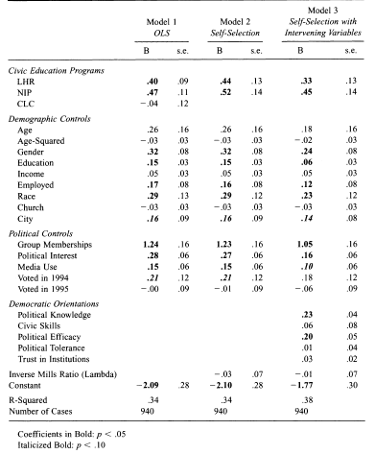
Multivar-iate Results for SA

Slide 52
Bivariate vs. Multivariate
Controlling for selection effects “completely eliminates the observed differences from Table 1 in participation rates for PC and ADOPEM individuals compared to the control group” (1008-9)

Slide 53
Significance and Substantive Effects
“Significant differences in overall participation rates remain… The effects for both programs in the Dominican Republic are substantively meaningful as well, with CE participation being among the strongest predictors of political behaviors among all variables in the table” (1009).
Notes:
“GAD’s effect on local participation in standard deviation terms is larger than any variable except for group memberships, while RSM’s effect rivals gender, political interest, and media exposure in size” (1009)

Slide 54
Comparing Across Models
“The model R-squared of .37, moreover, represents a substantial improvement over the .34 value from Table 2” (1013).
The conditional effects model does better than the regular model
We’ll come back to this next time with interaction terms

Slide 55
Essential Questions
How does multivariate regression work?
Why is it important to have the right model?
How are significance and substantive effect related?

Slide 56
Next Time…
Multivariate OLS in R
More on interpreting coefficients
More on R-squared and Adjusted R-squared

